Slide 1
Drilling & Countersinking
Aerospace Manufacturing Core Study Guide
“AMCSG-201”
Tools & Processes

Slide 2
Drilling

Slide 3
Drilling
Drilling a quality hole is crucial
Used to fasten parts together using rivets, screws, bolts, etc.
A quality hole must meet requirements for:
Location
Angularity
Dimension
Tolerance
Free of burrs & sharp edges
7/8”
dia
+/- 0.01”
1”
1”
45°
Matt Pierce, 2026
Notes:
Public Domain Image Sources:
I drew the diagram in PPT

Slide 4
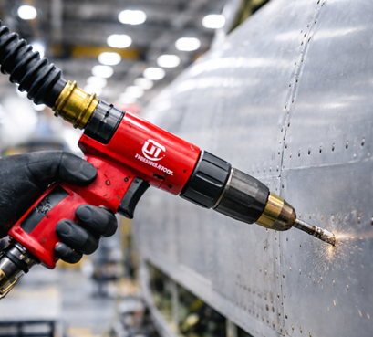
Basic Components of Drill Motor
Motor
Handle
Chuck
Drill Bit
Trigger
ChatGPT / Matt Pierce, 2026
Notes:
Image Credits:
ChatGPT “create a picture of a drill motor used in aerospace manufacturing” + “make it look like a universal tool drill motor in red color with a handle”

Slide 5
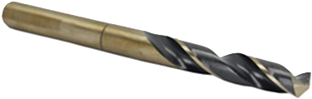
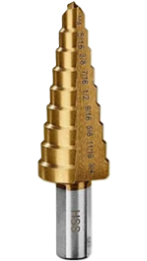
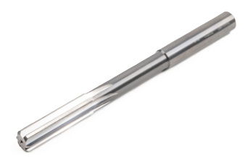
Types of Drill Bits
“Twist” Drill Bit
(Ad) Harbor Freight
(Ad) Home Depot
“Reamer” Drill Bit
“Step” Drill Bit
(Ad) Haas Tooling
Notes:
Twist Drill Bit = Make a hole
Step Drill Bit = Make holes at multiple diameters without switching bits
Reamer Bit = Make a hole larger with precision
Image Credits:
Twist Drill Bit – Home Depot for sale – (Ad) https://encrypted-tbn0.gstatic.com/shopping?q=tbn:ANd9GcQeeoYPcu5ci_x4HR2VdH7y6-sAVXKNv0LOCUGrIO9LadYaQLuCxAW8ZxF8_KiZZili1DXalQfKcaFhSHnGe4QnUZygBEqkz3k3qub5YYnc_PZSeOIK9Xb7Ew
Step Drill Bit – Harbor Freight for sale - (Ad) https://www.google.com/aclk?sa=L&ai=DChsSEwigvfGRjLySAxUCAK0GHbEyIF4YACICCAEQCxoCcHY&co=1&ase=2&gclid=CjwKCAiAs4HMBhBJEiwACrfNZfmzqSee-4-C3zrzit-f7FbVp14o5LOHpKcNJWzOQ_cXnjtj3BtAshoCmlcQAvD_BwE&cid=CAASZeRoMeva1YcWMovAG3zCu1ZF-pUUXTMIbAz6ylgte3YUbEInkB6XPFENRREicgoWGOyb2CSjRDL0GUtQRDJuMlX0ghYFg7PfBKyvW5NW-Zm-rJnSdBWfSNibxp5D9M1d3pNzDTzg&cce=2&category=acrcp_v1_32&sig=AOD64_2GqZQNW_kK2rRhwE5bHvL6ssmgbA&ctype=46&q=&ved=2ahUKEwjXsOuRjLySAxUdMzQIHbffBJMQ9aACKAB6BAgFEEs&adurl=
Reamer Drill Bit = Haas Tooling website (for sale) = https://www.haastooling.com/content/dam/haas-tooling/ecommerce/products/03/3239/image/03-3239.jpg/_jcr_content/renditions/original./03-3239.jpg

Slide 6
Parts of a Drill Bit
Shank
Flute
Land
Margin
Point Angle
(Ad) Home Depot
Higher Point Angle = harder materials (metal)
Lower Point Angle = softer materials
Notes:
Public Domain Image Sources:
Twist Drill Bit – Home Depot for sale - https://encrypted-tbn0.gstatic.com/shopping?q=tbn:ANd9GcQeeoYPcu5ci_x4HR2VdH7y6-sAVXKNv0LOCUGrIO9LadYaQLuCxAW8ZxF8_KiZZili1DXalQfKcaFhSHnGe4QnUZygBEqkz3k3qub5YYnc_PZSeOIK9Xb7Ew

Slide 7
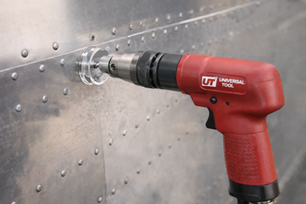
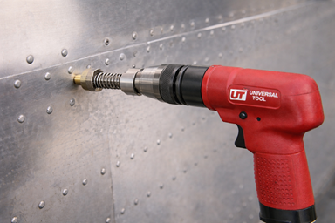
Drill Guides and Drill Stops
Drill Guide / Drill Block to control angle (e.g.: force perpendicular)
Drill Stop to control depth (e.g.: do not puncture below)
Drill Guide (Drill Block not shown)
Drill Stop
ChatGPT / Matt Pierce, 2026
ChatGPT / Matt Pierce, 2026
Notes:
Public Domain Image Sources:
Drill Guide: ChatGPT “make an image of a red pneumatic “universal tool” drill motor with handle drilling perpendicular into aircraft skin using a perpendicular drill guide” + “Use a clear round plastic drill guide, not the black L metal guide”
Drill Stop: Same ChatGPT above, but modified… “Change the drill guide into a drill stop. show the locking collar and spring. show a side view with drill penetrating the aluminum skin only so far“

Slide 8
Countersinking

Slide 9
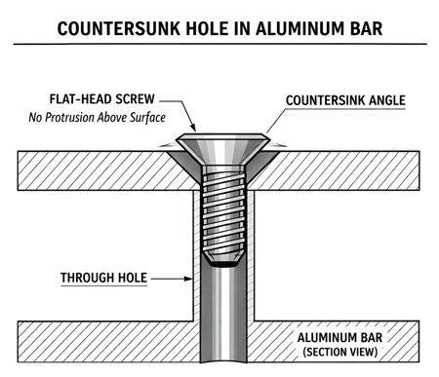
Countersinking
What: Countersink creates a conical hole so fastener sits flush
Why: Flush heads improve aerodynamics, reduce corrosion, etc.
ChatGPT / Matt Pierce, 2026
Notes:
Public Domain Image Sources:
Countersink hole image: ChatGPT “Make a diagram of a countersink hole thru an aluminum bar indicating how a screw head would sit flush” + “Redraw this as an ASTM-style engineering diagram. Format it exactly for a PowerPoint or training manual. One diagram. No drill stops. No drill guides.”

Slide 10
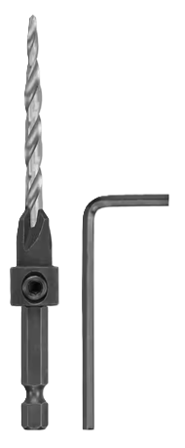
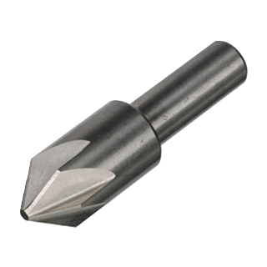
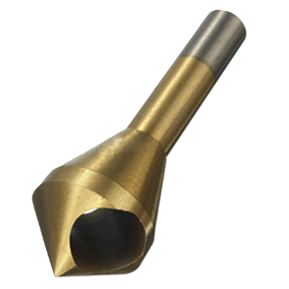
Types of Countersink Drill Bits
“Fluted” Bit
“Cross-Hole” Bit
“Back/Cogsdill” Bit
ChatGPT / Matt Pierce, 2026
ChatGPT / Matt Pierce, 2026
ChatGPT / Matt Pierce, 2026
Notes:
Three images from ChatGPT: “show me a picture of three different countersink bits: (1) Fluted countersink bit, (2) Cross-Hole countersink bit, and (3) Back countersink bit (aka Cogsdill).” + “Make all pictures show just one bit each, standing perpendicular”

Slide 11
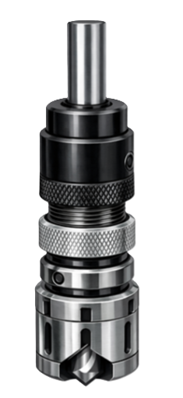
Microstop Tool (to control depth)
Shank
Body
Adjusting Threads
No metal-to-metal contact!
Always remember to protect surface with nylon foot or
protective tape
ChatGPT / Matt Pierce, 2026
Adjustment Sleeve
Locking Ring
Cage
Notes:
Image from ChatGPT: “make a diagram showing a microstop tool (for countersinking). Be sure to show the shank, the body, the adjusting threads, the adjustment sleeve, the locking ring, and the cage. Do not label anything.”

Slide 12
Q&A

Slide 13
Practice Q&A’s (Q1-Q8)
Q5: What purpose does the flute part of a drillbit server?
A: Allows waste material to exit the hole
Q6: What tool do you use when drilling to force perpendicular holes?
A: Drill guide
Q7: What tool do you use when drilling to control depth of the hole?
A: Drill stop
Q8: What is a hole called with a conical top into which a flat-head fastener can sit flush?
A: Countersink
Q1: What four requirements make a quality drilled hole?
A: Location, Angularity, Dimension, and Tolerance
Q2: What is the most common type of drill bit?
A: Twist drillbit
Q3: What type of drillbit lets you drill increasingly larger diameter holes without changing bits?
A: Step drillbit
Q4: What part of the drillbit is clamped into the chuck?
A: Shank

Slide 14
Practice Q&A’s (Q9-Q16)
Q13: Where is the diameter of the drillbit stamped?
A: On the shank
Q14: How is a chamfered hole different from a countersink hole?
A1: Chamfer is 45°, shallow, for safety/deburring, and easy fastener entry.
A2: Countersink is 82°-90°, deeper, tighter tolerance
Q15: What type of surface is most difficult to countersink?
A: Curved
Q16: How frequently should you test countersink holes?
A: Every 10 to 20 holes
Q9: Name three types of countersink drillbits?
A: 1. Fluted bit, 2. Cross-Hole bit, 3. Cogsdill bit
Q10: What tool do you use when drilling a countersink hole to control depth?
A: Microstop tool
Q11: What is not allowed for drillbits over six inches long?
A: Drilling speeds > 6,000RPM
Q12: Why is it important to drill quality holes?
A: Lowers cost and re-work. Increases airframe lifespan

Slide 15
Practice Q&A’s (Q17-Q19)
Q17: What is the name of the extra material in a slight radius between the shank and the head of a fastener used to strengthen it to avoid snapping there when you turn with screwdriver or wrench?
A: Fillet
Q18: What keeps the Cogsdill bit accurately centered in the drilled hole?
A: Pilot (hole and bit)
Q19: How should flush fasteners sit inside the countersunk hole?
A: Flush or slightly above ... but never below (risk b/c metal skin already too thin)

Slide 16
Thank You
Matt Pierce - mpierce710006@gmail.com - linkedin.com/in/mpiercead576/
https://github.com/DataResearchLabs/study_guide_intro_aerospace_mfg

